Slide 1
UNIT 3

Slide 2
Introduction to Algorithms Greedy Algorithms

Slide 3
A short list of categories
Algorithm types we will consider include:
Simple recursive algorithms
Backtracking algorithms
Divide and conquer algorithms
Dynamic programming algorithms
Greedy algorithms
Branch and bound algorithms
Brute force algorithms
Randomized algorithms

Slide 4
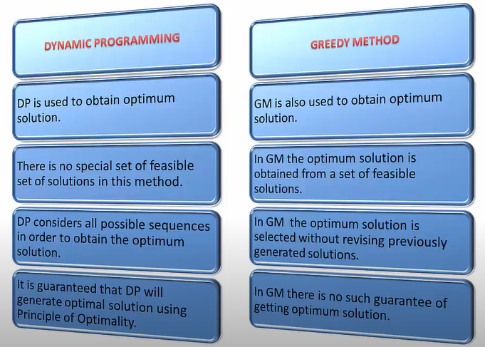

Slide 5
Optimization Problems
For most optimization problems you want to find, not just a solution, but the best solution.
A greedy algorithm sometimes works well for optimization problems. It works in phases. At each phase:
You take the best you can get right now, without regard for future consequences.
You hope that by choosing a local optimum at each step, you will end up at a global optimum.
Notes:
2

Slide 6
Example: Counting Money
Suppose you want to count out a certain amount of money, using the fewest possible bills and coins
A greedy algorithm to do this would be: At each step, take the largest possible bill or coin that does not overshoot
Example: To make $6.39, you can choose:
a $5 bill
a $1 bill, to make $6
a 25¢ coin, to make $6.25
A 10¢ coin, to make $6.35
four 1¢ coins, to make $6.39
For US money, the greedy algorithm always gives the optimum solution
Notes:
3

Slide 7
Greedy Algorithm Failure
In some (fictional) monetary system, “krons” come in 1 kron, 7 kron, and 10 kron coins
Using a greedy algorithm to count out 15 krons, you would get
A 10 kron piece
Five 1 kron pieces, for a total of 15 krons
This requires six coins
A better solution would be to use two 7 kron pieces and one 1 kron piece
This only requires three coins
The greedy algorithm results in a solution, but not in an optimal solution
Notes:
4

Slide 8
A Scheduling Problem
You have to run nine jobs, with running times of 3, 5, 6, 10, 11, 14, 15, 18, and 20 minutes.
You have three processors on which you can run these jobs.
You decide to do the longest-running jobs first, on whatever processor is available.
P1
P2
P3
20
10
3
18
11
6
15
14
5
Time to completion: 18 + 11 + 6 = 35 minutes
This solution isn’t bad, but we might be able to do better
Notes:
5

Slide 9
Another Approach
What would be the result if you ran the shortest job first?
Again, the running times are 3, 5, 6, 10, 11, 14, 15, 18, and 20 minutes
P1
P2
P3
3
10
15
5
11
18
6
14
20
That wasn’t such a good idea; time to completion is now 6 + 14 + 20 = 40 minutes
Note, however, that the greedy algorithm itself is fast
All we had to do at each stage was pick the minimum or maximum
Notes:
6

Slide 10
An Optimum Solution
Better solutions do exist:
P1
P2
P3
20
14
18
11
5
15
10
6
3
This solution is clearly optimal (why?)
Clearly, there are other optimal solutions (why?)
How do we find such a solution?
One way: Try all possible assignments of jobs to processors
Unfortunately, this approach can take exponential time
Notes:
7

Slide 11
Huffman Codeing
Message: BCCABBDDAECCBBAEDDCC

Slide 12
Huffman encoding
The Huffman encoding algorithm is a greedy algorithm
Given the percentage the each character appears in a corpus, determine a variable-bit pattern for each char.
You always pick the two smallest percentages to combine.
100%
54%
27%
46%
15%
22% 12% 24% 6% 27% 9% A B C D E F
Notes:
8

Slide 13
Huffman Encoding
100%
100%
54%
0
1
A=00 B=100 C=01 D=1010 E=11 F=1011
54%
27%
46%
0
1
27%
E
46%
15%
A
C
B
15%
A B C D E F
D
F
Average bits/char: 0.22*2 + 0.12*3 + 0.24*2 + 0.06*4 + 0.27*2 + 0.09*4 = 2.42
The solution found doing this is an optimal solution.
The resulting binary tree is a full tree.

Slide 14
Analysis
A greedy algorithm typically makes (approximately) n choices for a problem of size n
(The first or last choice may be forced)
Hence the expected running time is: O(n * O(choice(n))), where choice(n) is making a choice among n objects
Counting: Must find largest useable coin from among k sizes of coin (k is a constant), an O(k)=O(1) operation;
Therefore, coin counting is (n)
Huffman: Must sort n values before making n choices
Therefore, Huffman is O(n log n) + O(n) = O(n log n)
Notes:
11

Slide 15
Connecting Wires
There are n white dots and n black dots, equally spaced, in a line
You want to connect each white dot with some one black dot, with a minimum total length of “wire”
Example:
Total wire length above is 1 + 1 + 1 + 5 = 8
Do you see a greedy algorithm for doing this?
Does the algorithm guarantee an optimal solution?
Can you prove it?
Can you find a counterexample?

Slide 16
Collecting Coins
A checkerboard has a certain number of coins on it
A robot starts in the upper-left corner, and walks to the bottom left-hand corner
The robot can only move in two directions: right and down
The robot collects coins as it goes
You want to collect all the coins using the minimum number of robots
Example:
Do you see a greedy algorithm for doing this?
Does the algorithm guarantee an optimal solution?
Can you prove it?
Can you find a counterexample?

Slide 17
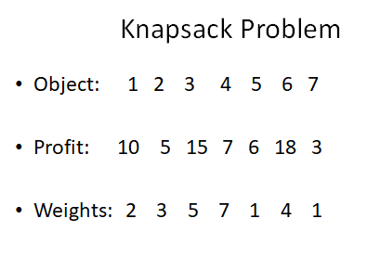

Slide 18
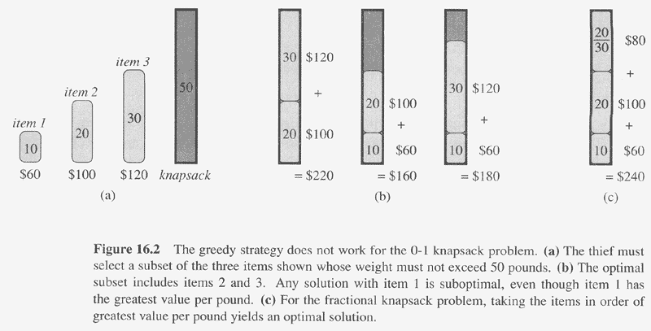
0-1 Knapsack

Slide 19
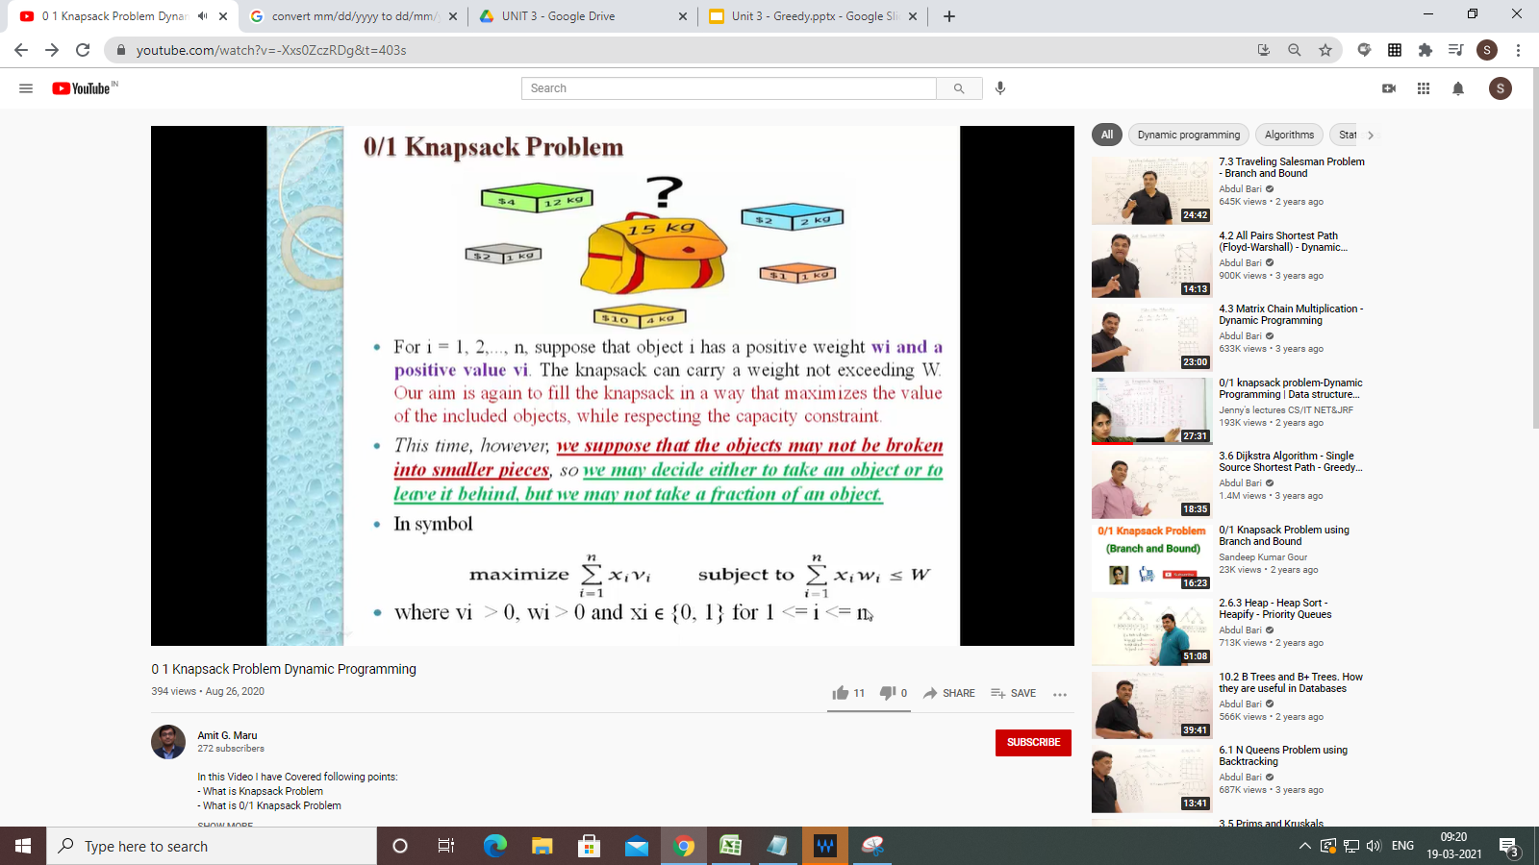
Refer: https://www.youtube.com/watch?v=-Xxs0ZczRDg&t=403s

Slide 20
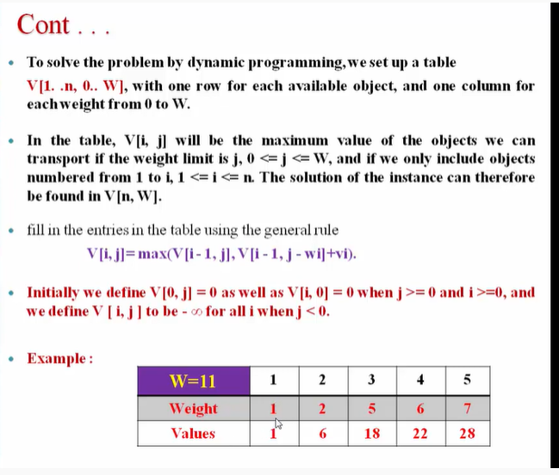

Slide 21
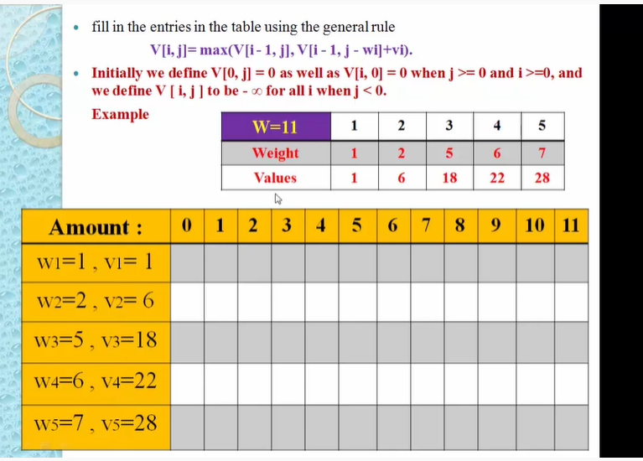

Slide 22
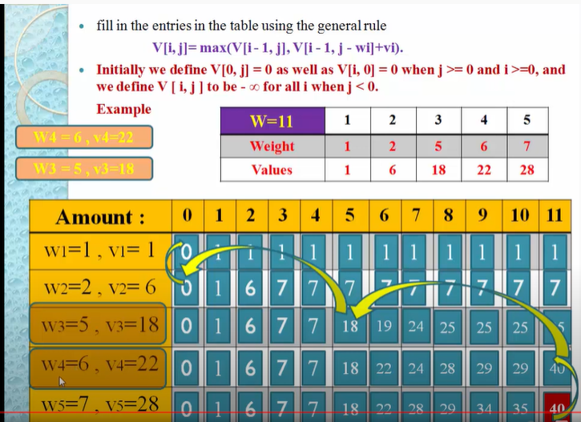

Slide 23
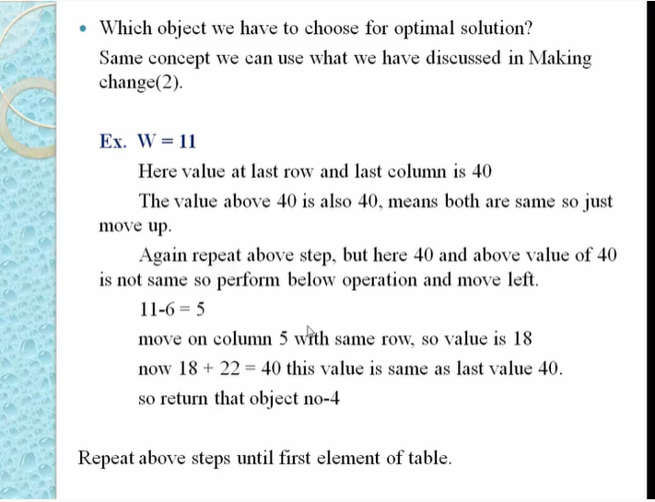

Slide 24
0-1-knapsack-problem Reference Example
ttps://www.javatpoint.com/0-1-knapsack-problem

Slide 25
Minimum spanning tree
A minimum spanning tree is a least-cost subset of the edges of a graph that connects all the nodes
Start by picking any node and adding it to the tree
Repeatedly: Pick any least-cost edge from a node in the tree to a node not in the tree, and add the edge and new node to the tree
Stop when all nodes have been added to the tree
6
The result is a least-cost (3+3+2+2+2=12) spanning tree
If you think some other edge should be in the spanning tree:
Try adding that edge
Note that the edge is part of a cycle
To break the cycle, you must remove the edge with the greatest cost
This will be the edge you just added
4
2
1
4
5
3
2
3
3
2
3
3
2
4
4
Notes:
9

Slide 26
Traveling salesman
A salesman must visit every city (starting from city A), and wants to cover the least possible distance
He can revisit a city (and reuse a road) if necessary
He does this by using a greedy algorithm: He goes to the next nearest city from wherever he is
From A he goes to B
From B he goes to D
This is not going to result in a shortest path!
The best result he can get now will be ABDBCE, at a cost of 16
An actual least-cost path from A is ADBCE, at a cost of 14
A
B
C
2
4
3
3
4
4
D
E
Notes:
10

Slide 27
Analysis
A greedy algorithm typically makes (approximately) n choices for a problem of size n
(The first or last choice may be forced)
Hence the expected running time is: O(n * O(choice(n))), where choice(n) is making a choice among n objects
Counting: Must find largest useable coin from among k sizes of coin (k is a constant), an O(k)=O(1) operation;
Therefore, coin counting is (n)
Huffman: Must sort n values before making n choices
Therefore, Huffman is O(n log n) + O(n) = O(n log n)
Minimum spanning tree: At each new node, must include new edges and keep them sorted, which is O(n log n) overall
Therefore, MST is O(n log n) + O(n) = O(n log n)
Notes:
11

Slide 28
Other Greedy Algorithms
Dijkstra’s algorithm for finding the shortest path in a graph
Always takes the shortest edge connecting a known node to an unknown node
Kruskal’s algorithm for finding a minimum-cost spanning tree
Always tries the lowest-cost remaining edge
Prim’s algorithm for finding a minimum-cost spanning tree
Always takes the lowest-cost edge between nodes in the spanning tree and nodes not yet in the spanning tree

Slide 29
Other Algorithm Categories
Brute Force
Selection Sort
Divide-and-Conquer
Quicksort
Decrease-and-Conquer
Insertion Sort
Transform-and-Conquer
Heapsort
Dynamic Programming
Greedy Algorithms
Iterative Improvement
Simplex Method, Maximum Flow
From The Design & Analysis of Algorithms, Levitin

